Slide 1
Fetal health classification
Avinash Sankar
Jeff Nicolas Olarte

Slide 2



Objective
Determine the health of fetus using cardiotocograms (CTGs) data to enable healthcare professionals to make earlier decisions and therefore increase the likelihood of the fetus’s survival.

Slide 3

Dataset Description
On This Dataset Cardiotocograms (CTGs) are a simple and cost accessible option to assess fetal health, allowing healthcare professionals to take action in order to prevent child and maternal mortality. The equipment itself works by sending ultrasound pulses and reading its response, thus shedding light on fetal heart rate (FHR), fetal movements, uterine contractions and more.
This dataset contains 2126 records of features extracted from Cardiotocogram exams, which were then classified by expert obstetrician into 3 classes:
Normal
Suspect
Pathological

Slide 4
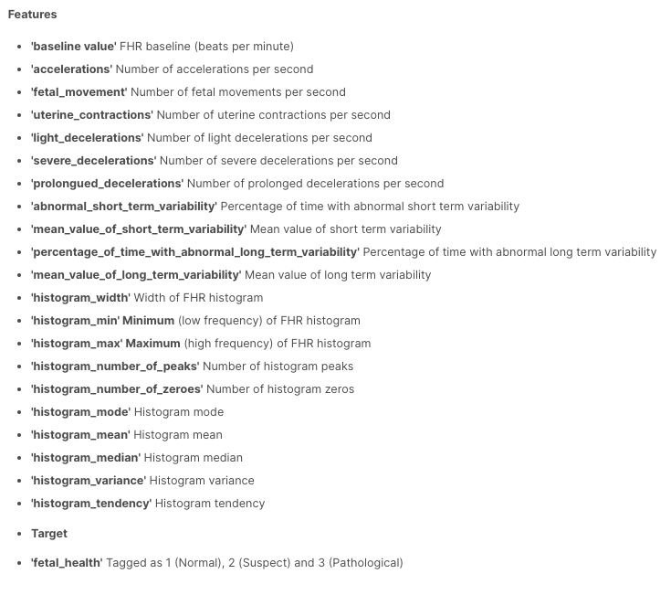
We are using the Kaggle dataset for fetal health classification.
The dataset consist of 2126 rows and 22 features.

Slide 5

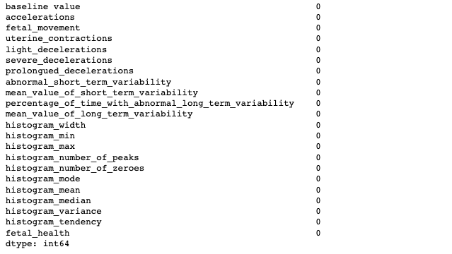
Checking whether the dataset has missing values

Slide 6
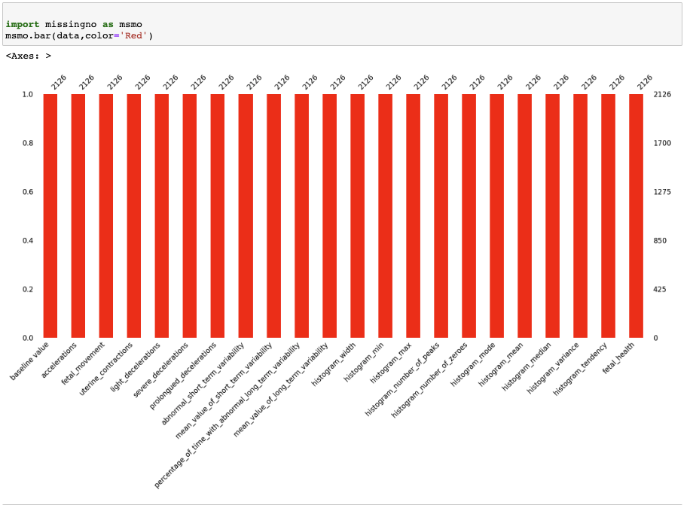
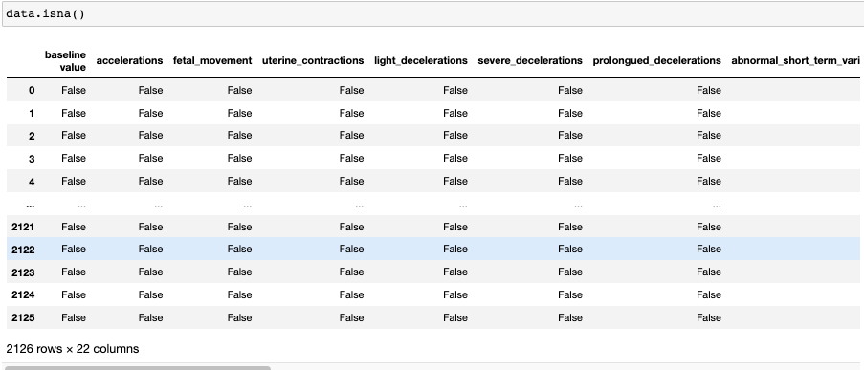
Making sure again the dataset has missing values

Slide 7
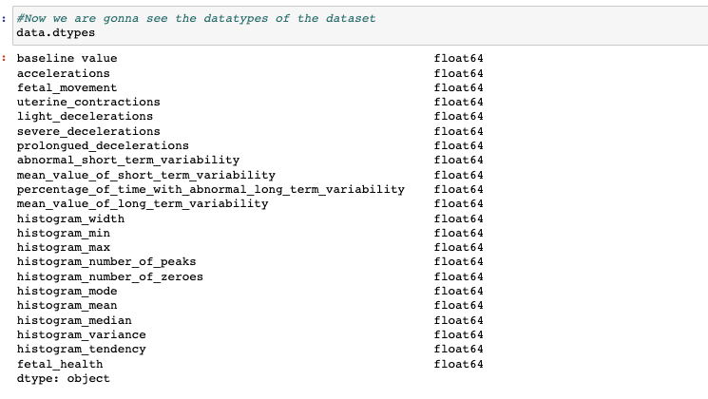
Understanding the datatypes of the data

Slide 8
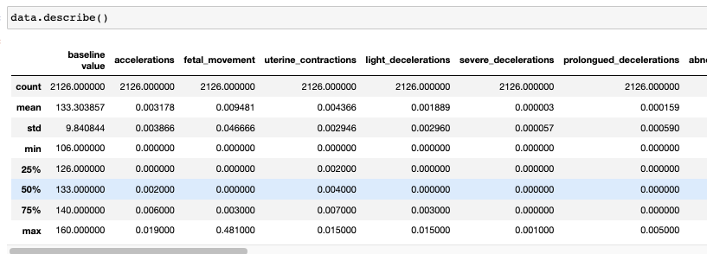
Visualizing the datasets mean,std,min,max,count

Slide 9
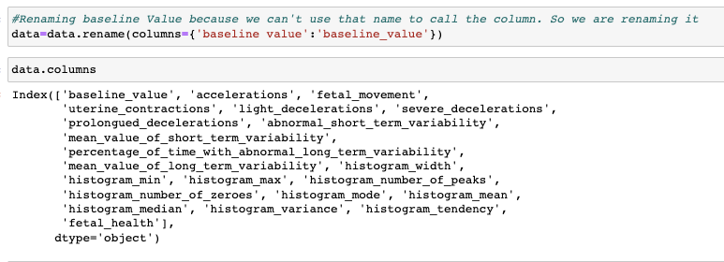
Renaming the baseline value features

Slide 10
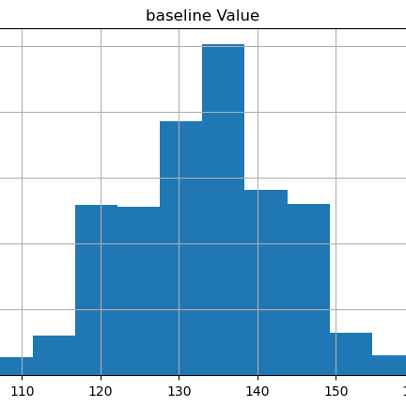
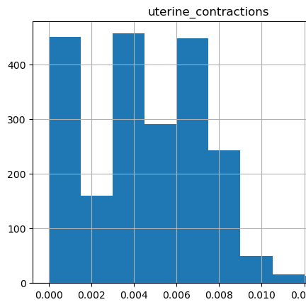
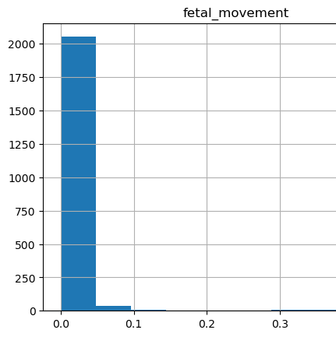
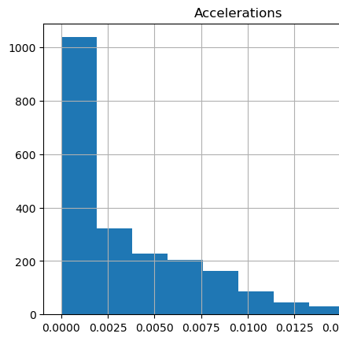
Now, we are plotting histogram plots for visualizing the features

Slide 11
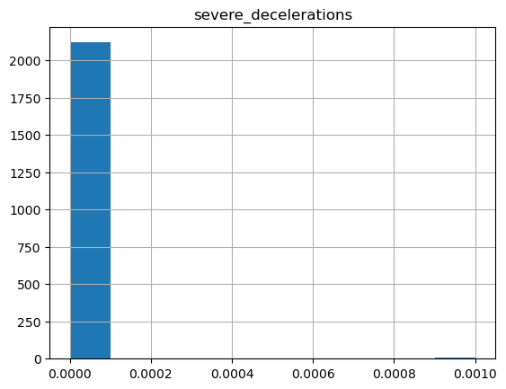
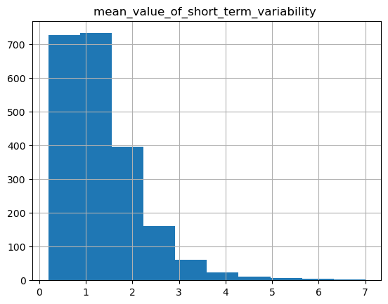
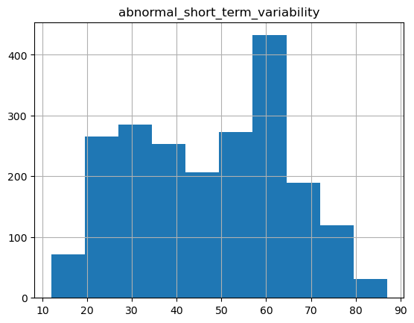
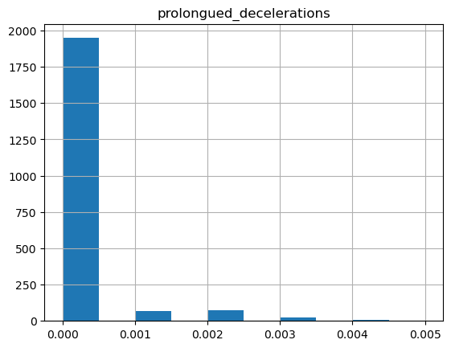
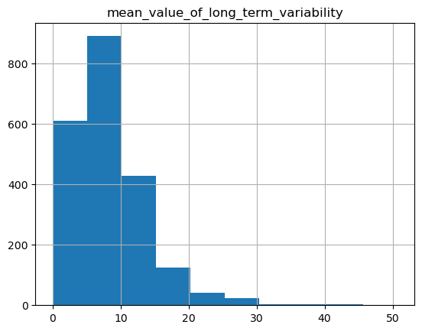
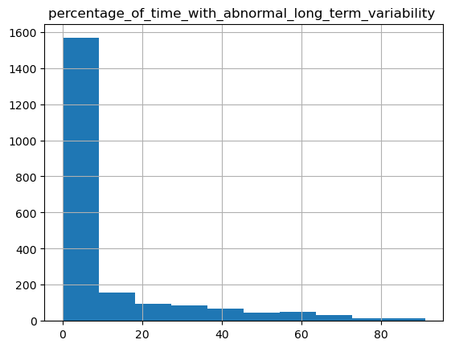

Slide 12
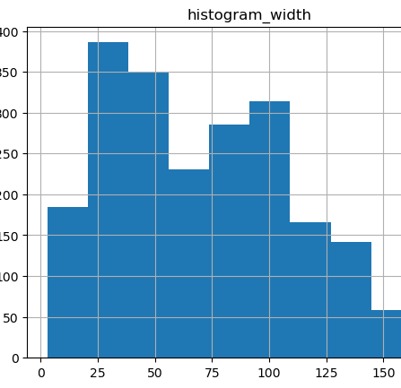
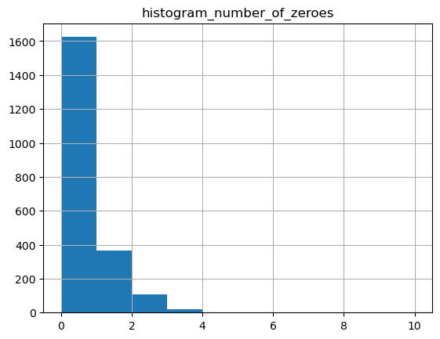
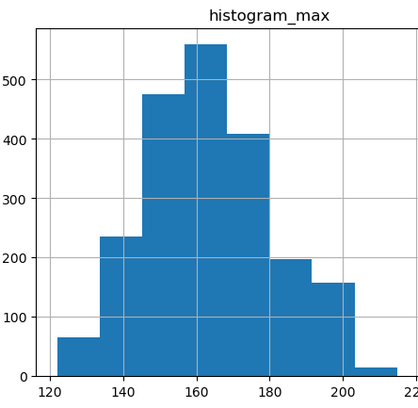
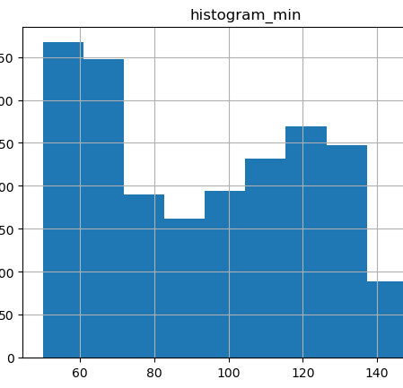
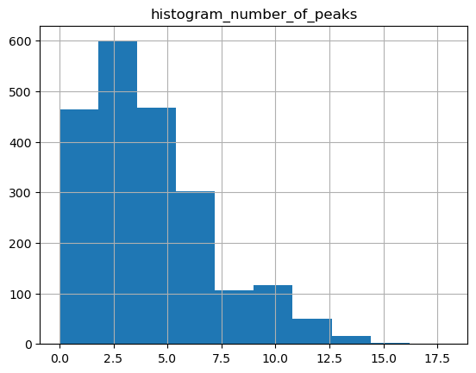

Slide 13
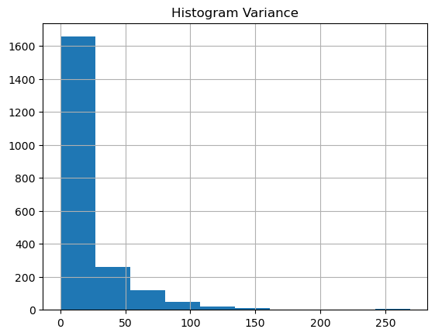
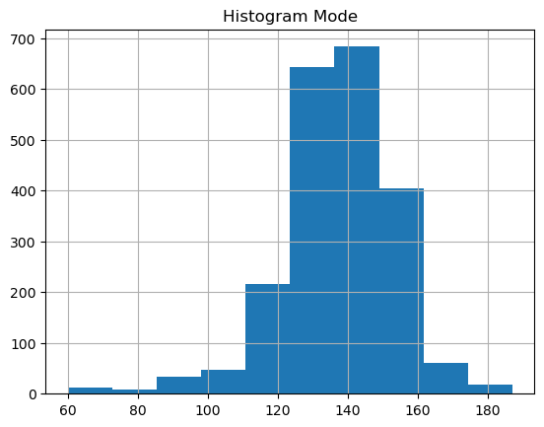
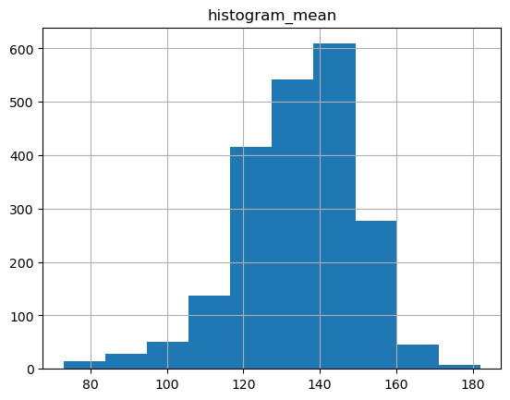
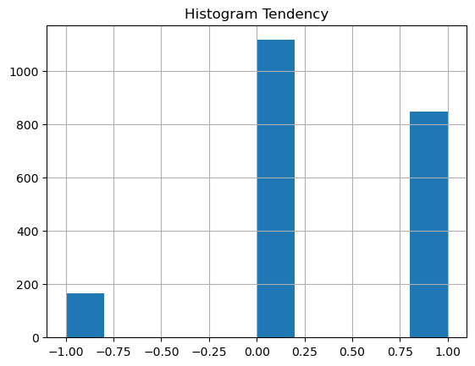


Slide 14
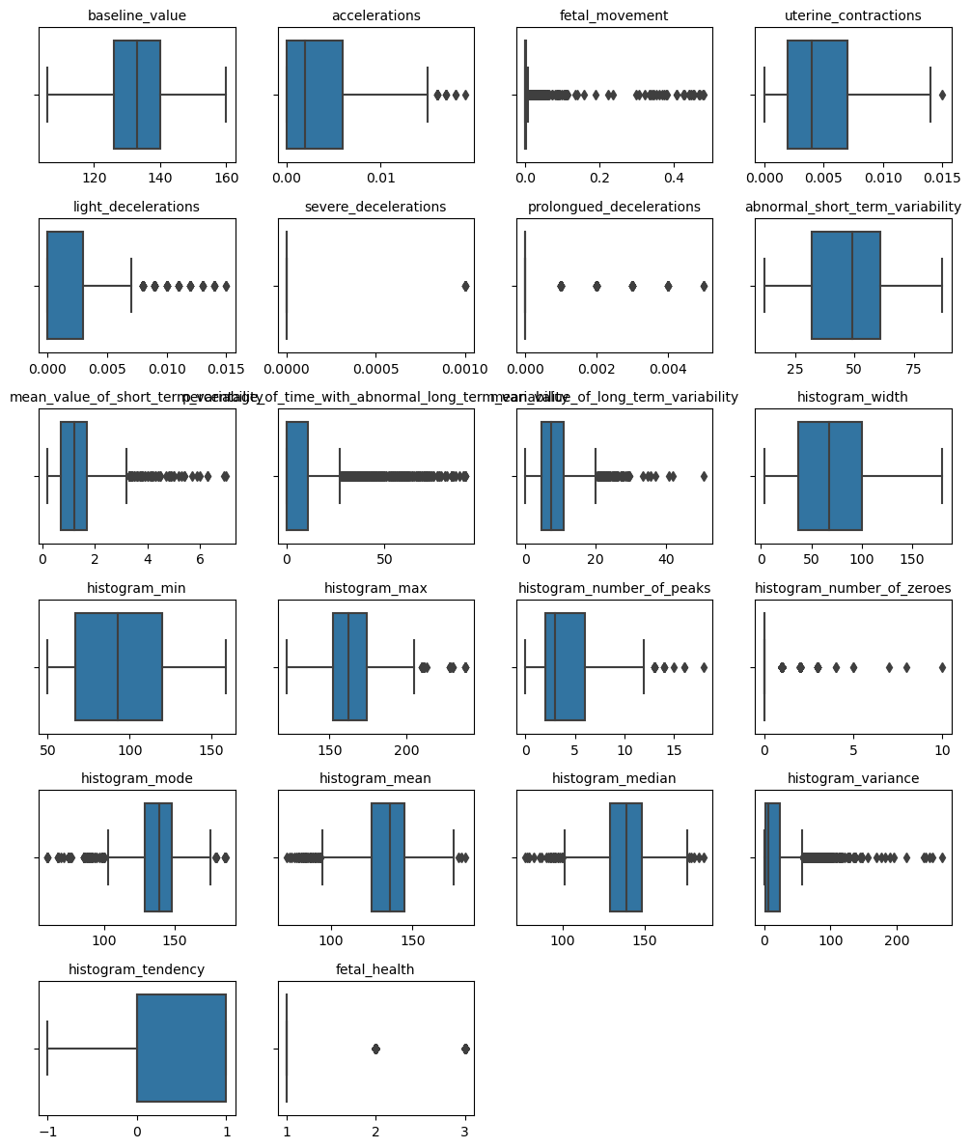
Checking whether there is outliers
From the boxplot, we can see that many boxplot exhibits outliers.Moreover, the data was extracted and interepted by Experts.It is believed that these observation may not be outliers in the actual clinical tests. They could indicate of various factors, such as fetal distress, maternal condition. No action needed to be taken in the outliers.

Slide 15
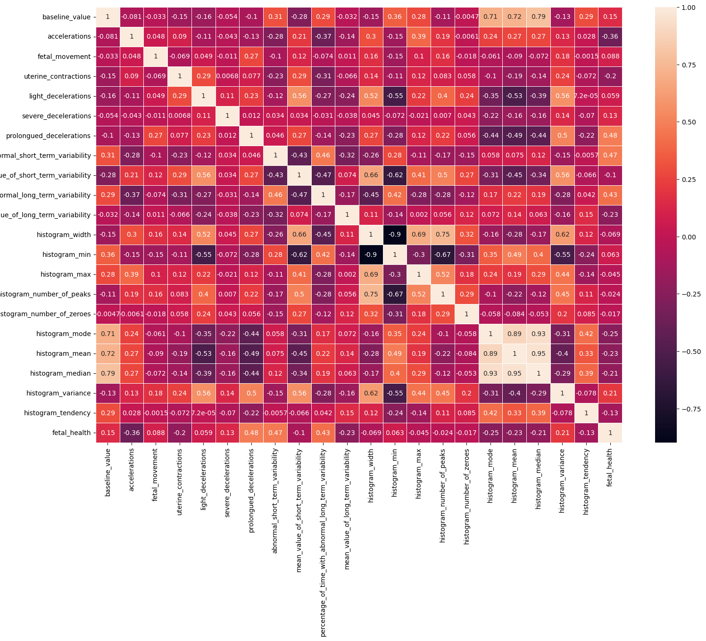
Correlation
From the correlation plot , we can see the relationship of features and we can determine we should keep for running the model.

Slide 16
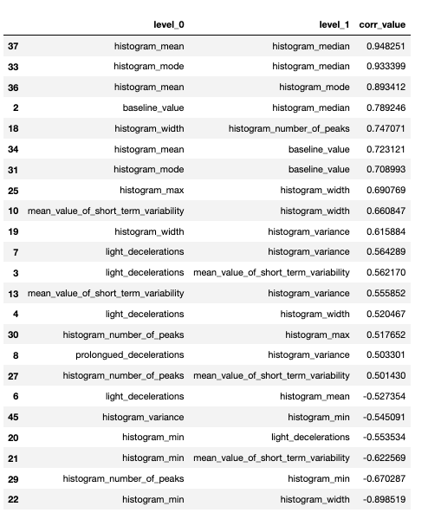
From the observation, we can see that the histogram mean , histogram mode, histogram median are highly correlated with each other and it positive correlation
For negative correlation, we can see that histogram_min and histogram width are highly correlated.

Slide 17
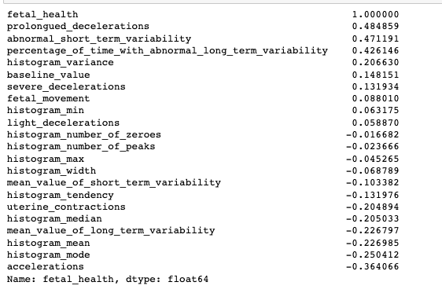
Finding the correlation with the predictor and the target value
Prolongued_decelerations 0.484859
abnormal_short_term_variability 0.471191
percentage_of_time_with_abnormal_long_term_variability 0.426146
These are positively correlated with fetal health.
The correlation which are below <0.1 are considered as no correlation

Slide 18
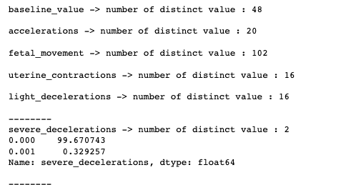
Checking the distinct values in the data

Slide 19
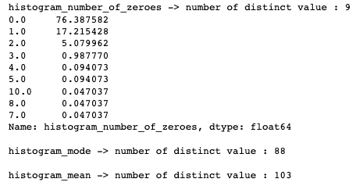
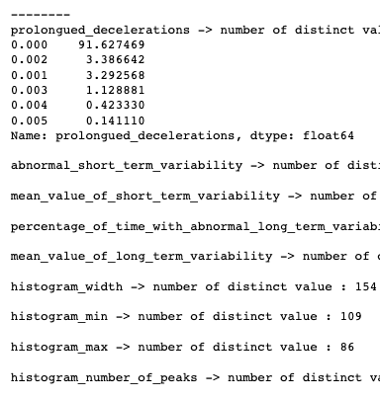
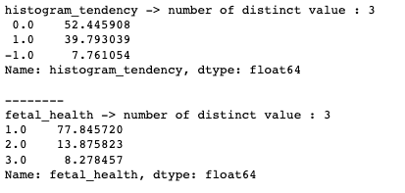

Slide 20
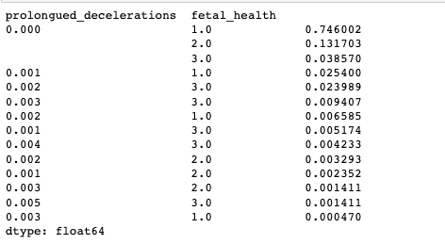
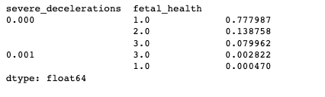
This two features severe decelerations and prolongues decelerations have less distinct values and also have more than 99% values are same. We can drop these two columns and proceed.

Slide 21
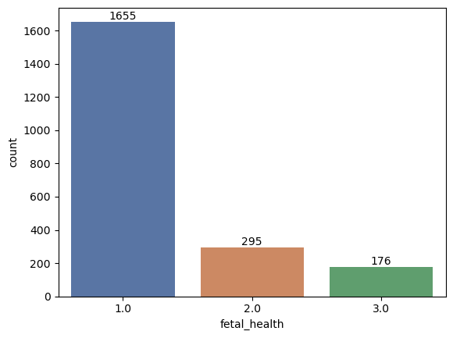
Visualizing the fetal health distribution

Slide 22
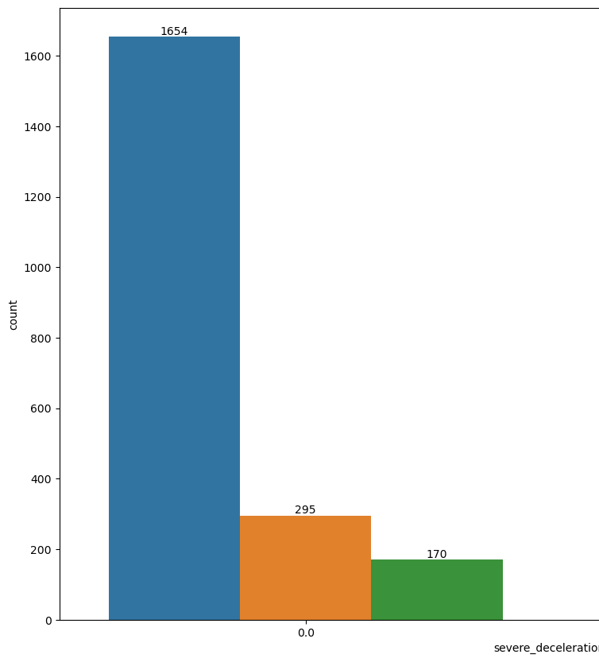
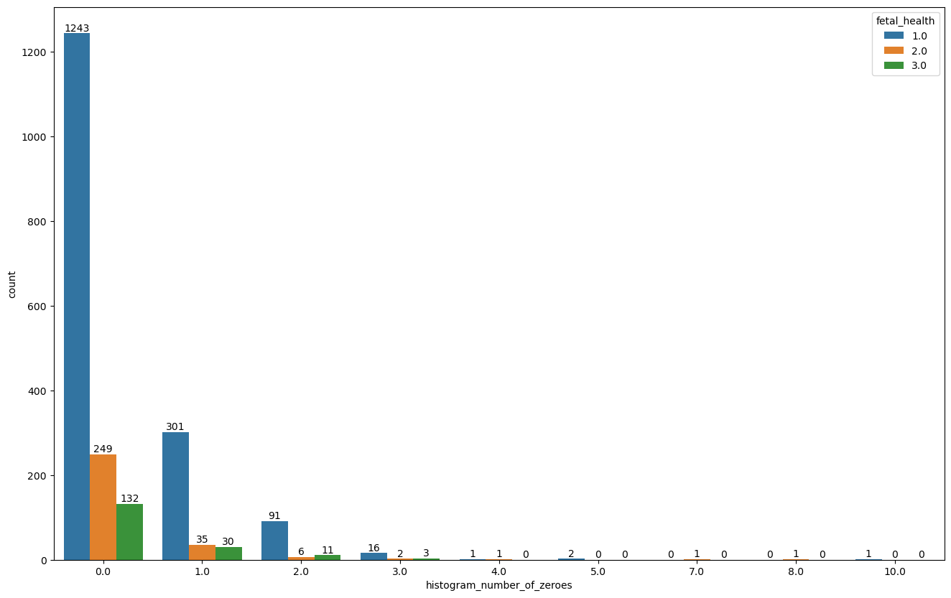
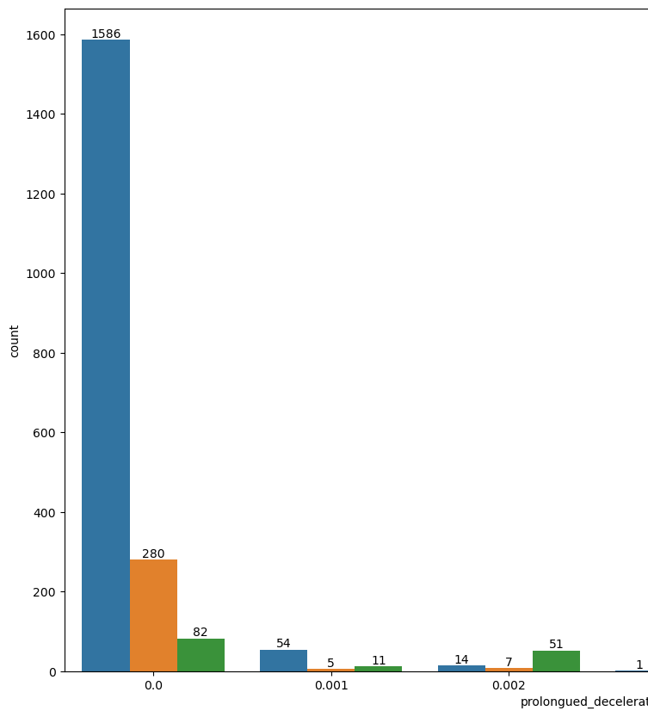
Now, we are gonna visualize the distribution of fetal health with the features

Slide 23
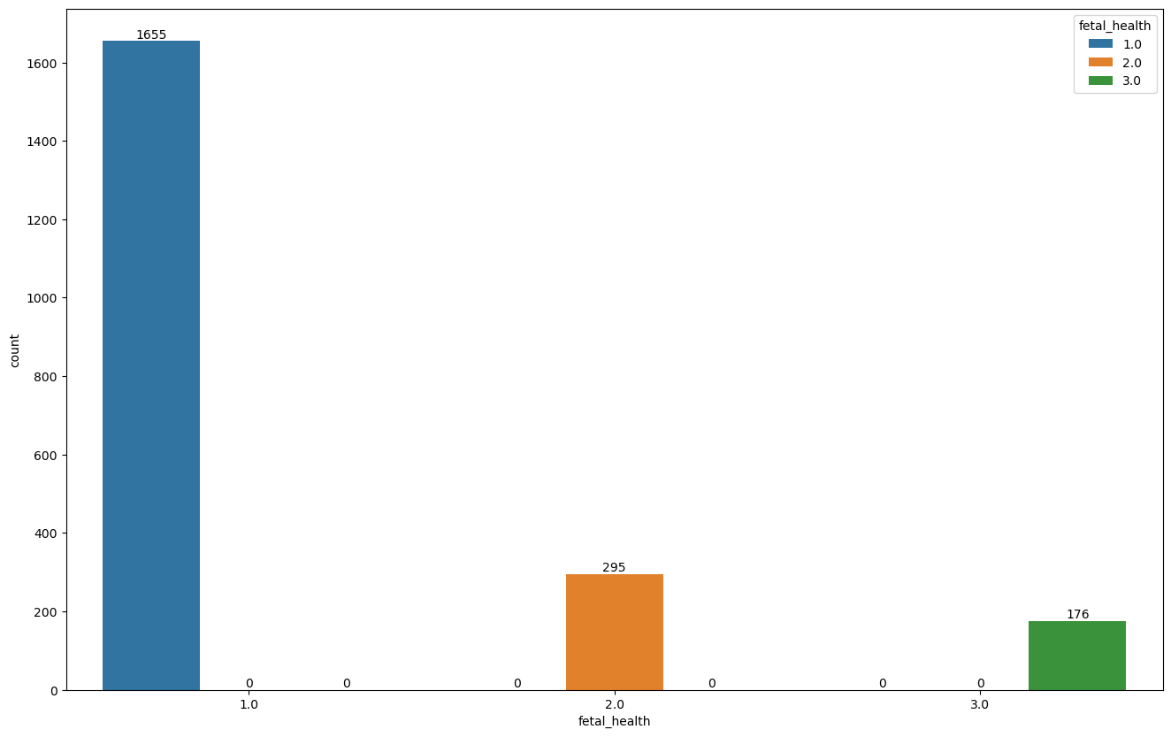
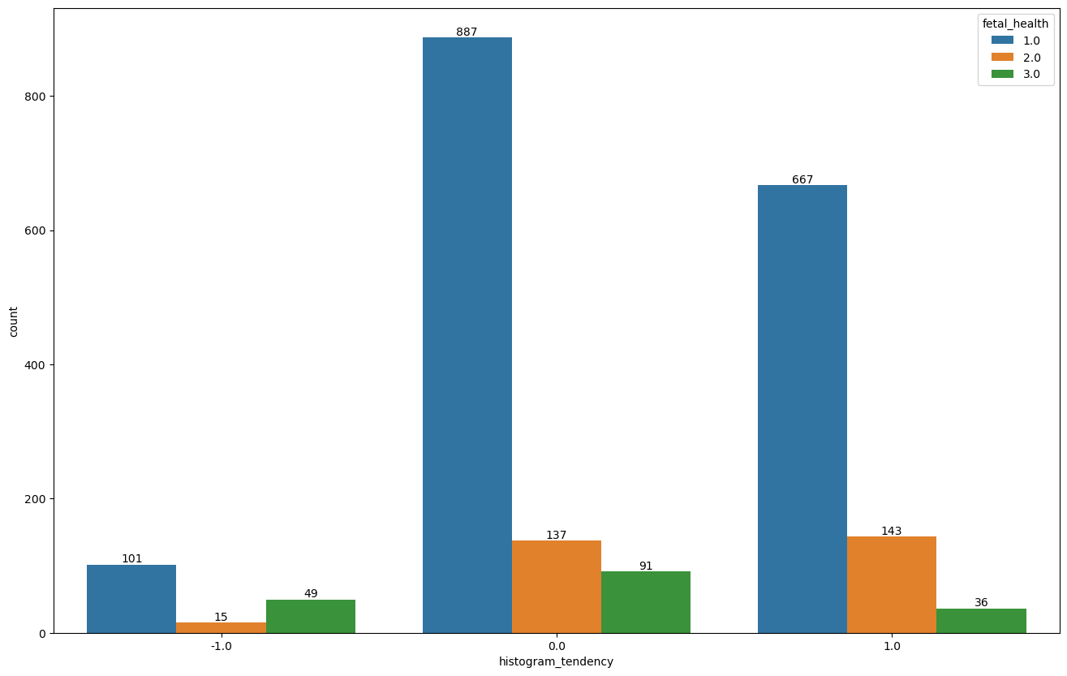

Slide 24
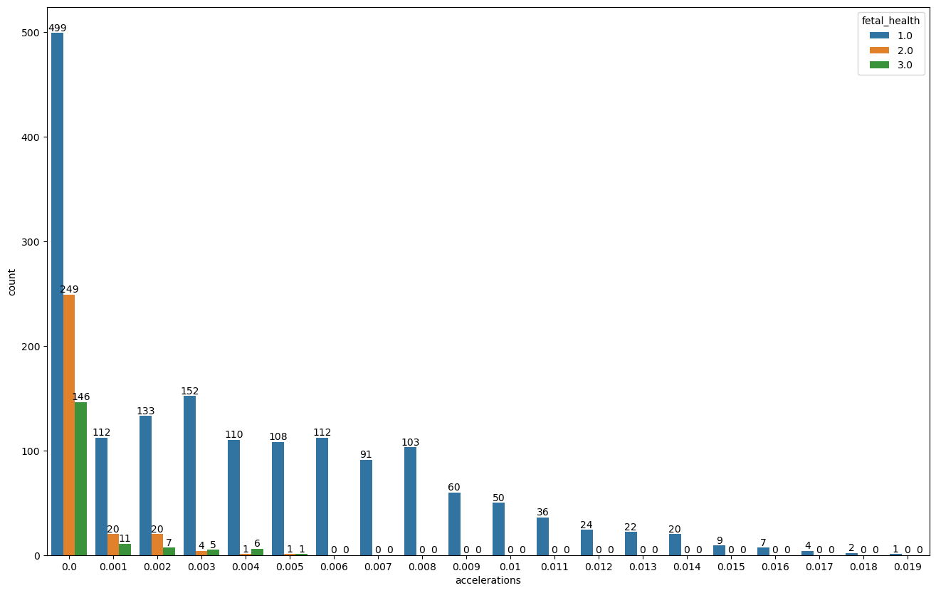
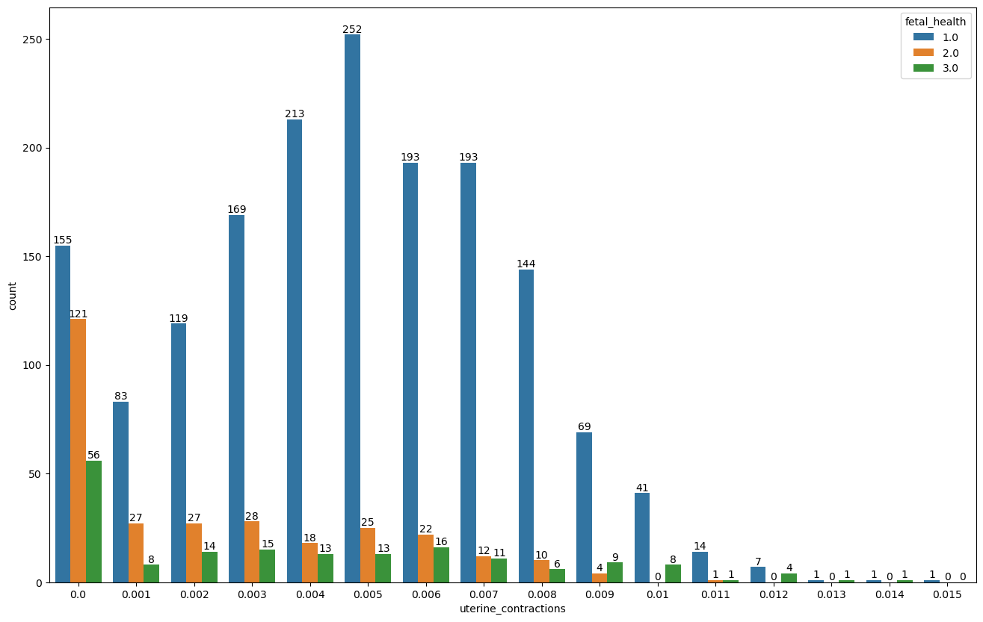
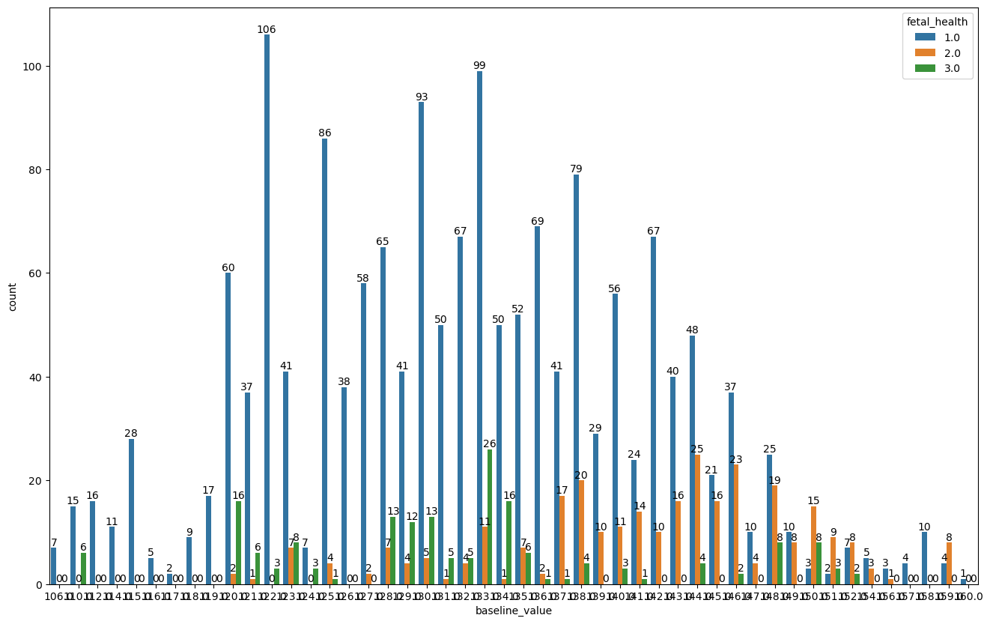
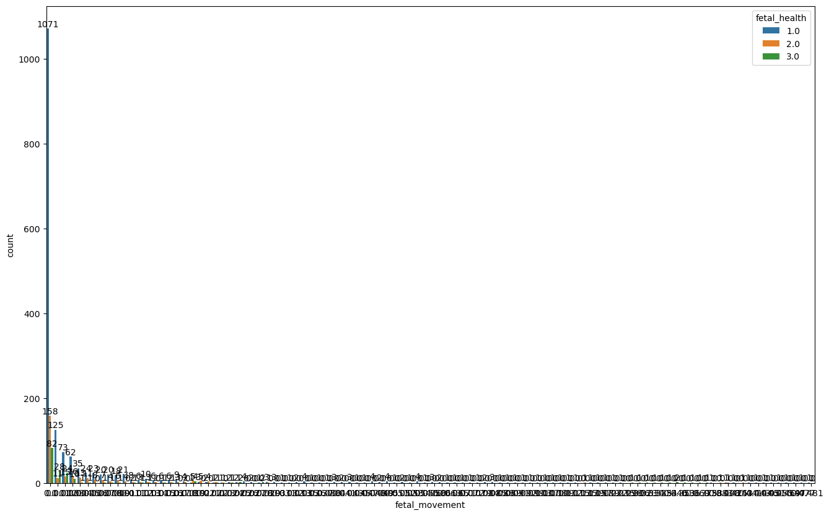

Slide 25
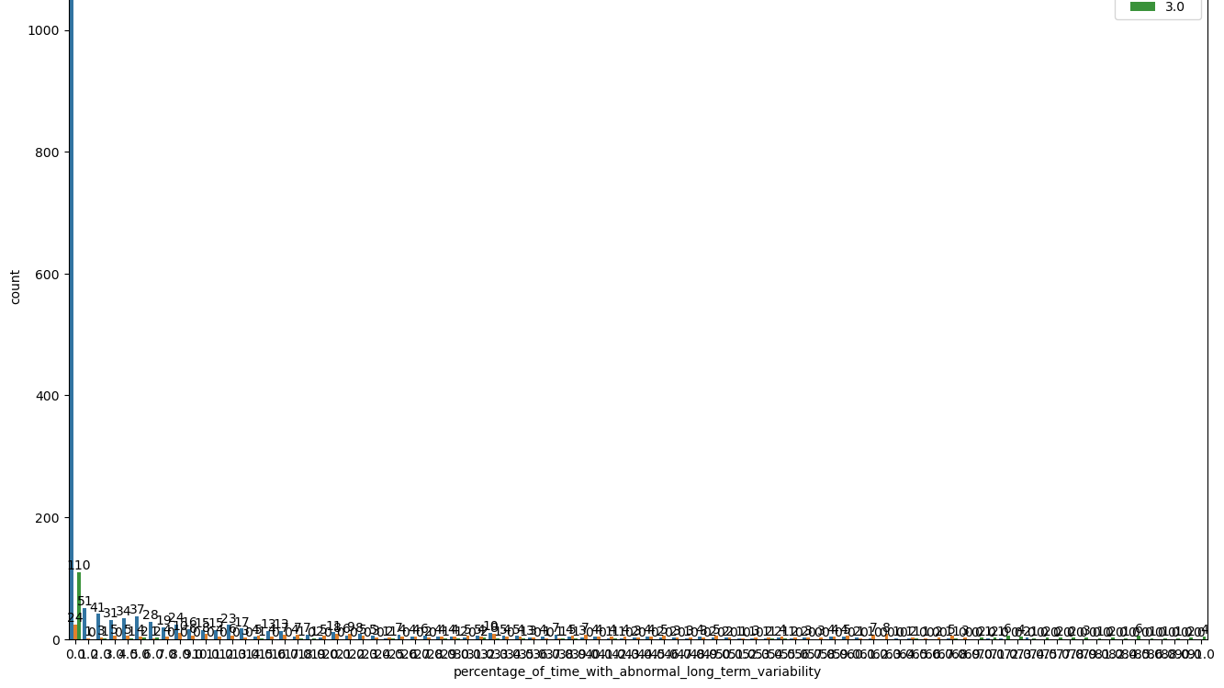
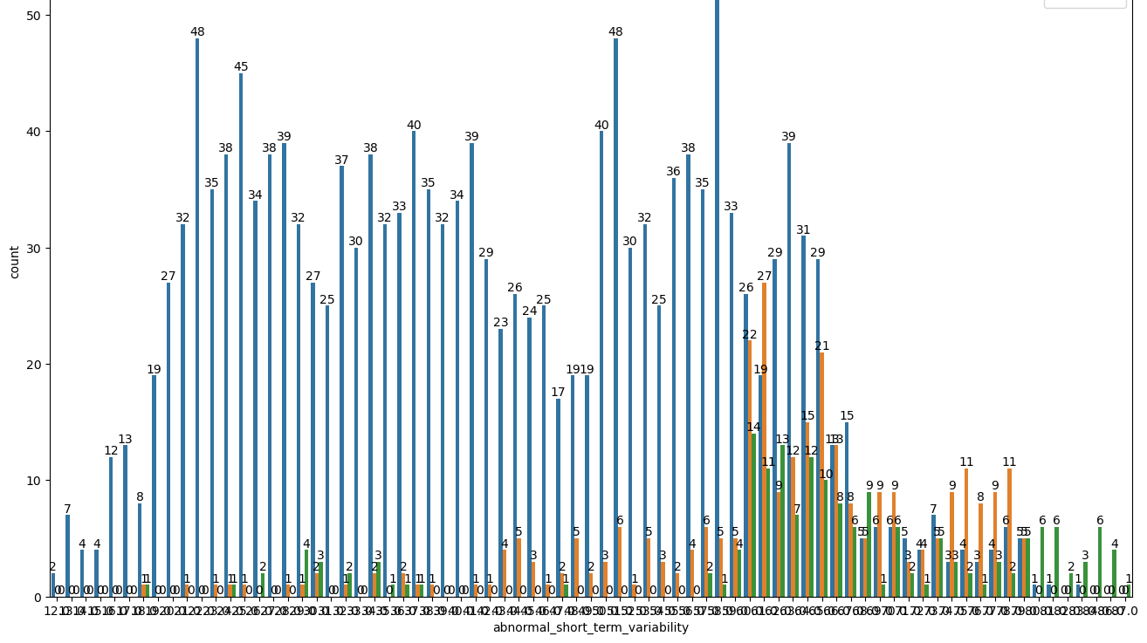
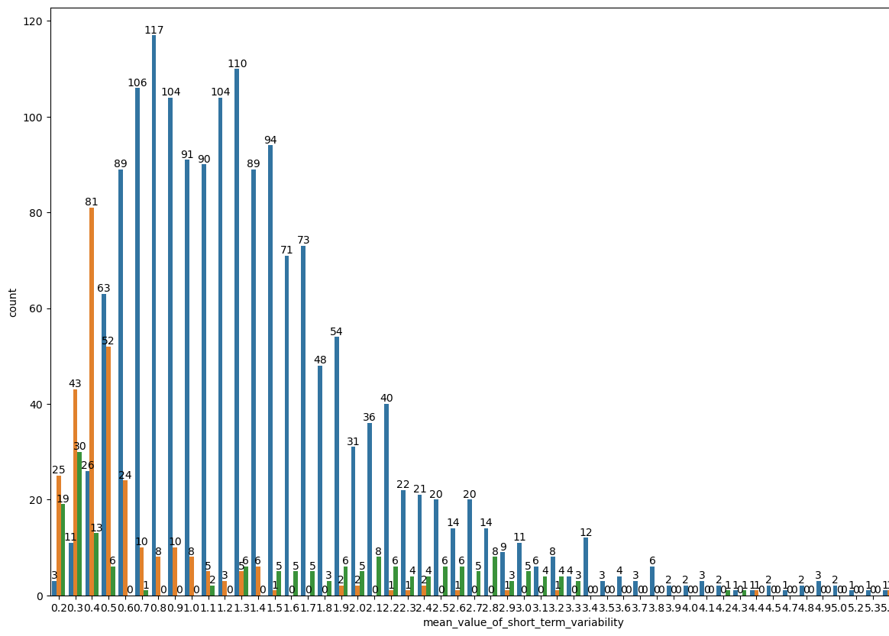
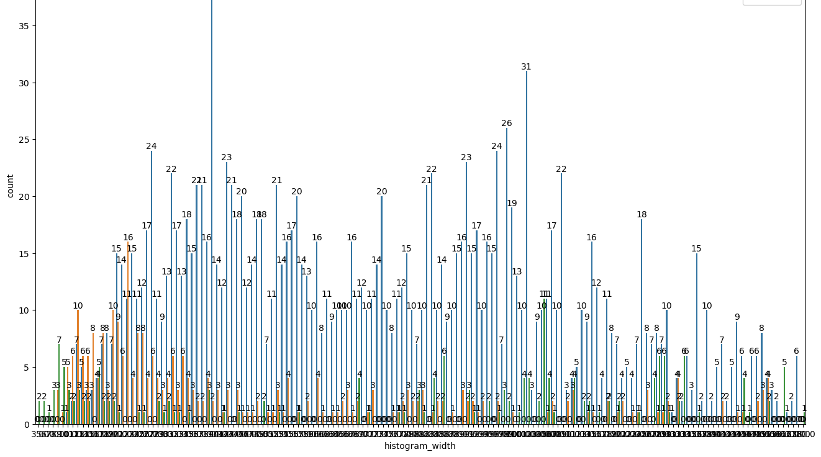


Slide 26






Slide 27



Slide 28
Next step
Reducing the features by correlation
Train and test split
Building the model

Slide 29
Light Gbm
Random forest
Gradient boosting
And visualizing the accuracy ,precision and f1 score of the model.
Compare the result with every model and concluding it.

